Slide 1
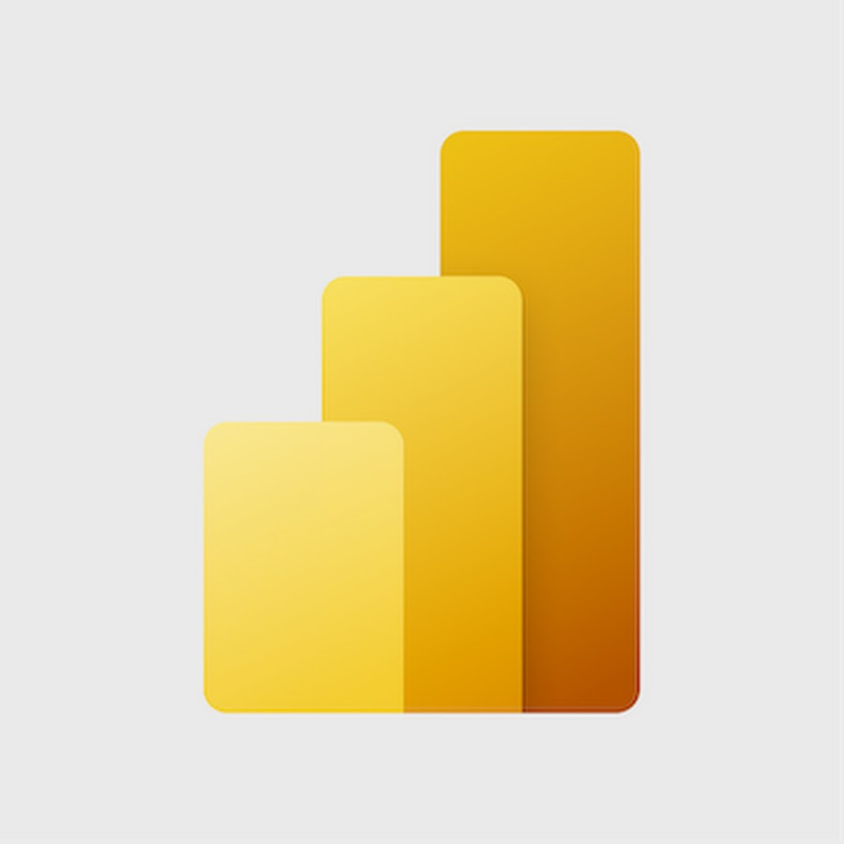
Power BI Report
Yashaswani sharma

Slide 2
Tool Description
Power BI Desktop is the local window desktop. Microsoft created the free desktop programme Power BI Desktop. Users may connect, evaluate, analyse, and display data from numerous sources with this effective business intelligence application. Power BI Desktop is primarily used to create engaging desktop and reports that facilitate data analysis and decision-making using data. The primary attributes and capabilities of Power BI Desktop are as follows:
Data connectivity
Data transformation and modelling
Data visualisation
Interactivity
DAX (Data Analysis Expressions)
Report Design
Collaboration and Sharing

Slide 3
Sales Analysis Report
The purpose of creating a sales analysis report in Power BI is to gain valuable insights into an organization's sales performance, identify trends, patterns, and opportunities, and make data-driven decisions to optimize sales strategies.
In this report I have shown all the aspects such as sales analysis, sales vs. target sales, quantity sales vs. quantity target, gross profit, and period vise analysis. By doing this, I have made 5 separate pages in the sales report, and each page has different sets of visuals that give a detail related to the sales.

Slide 4
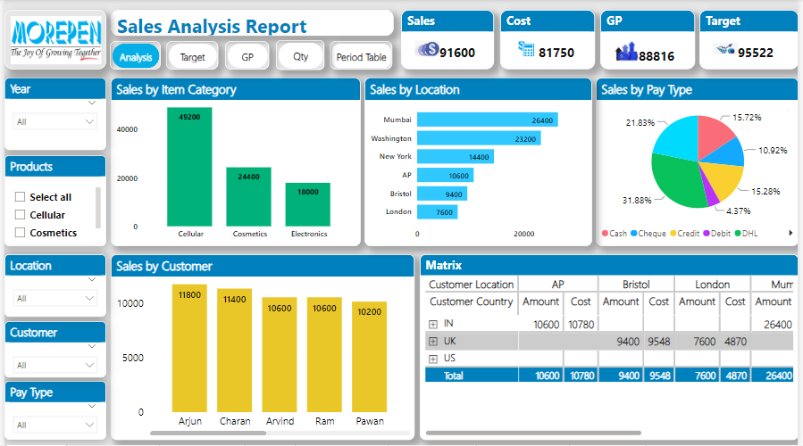
On this page, sales analysis is shown, which means the actual sales by different sets of categories are displayed.

Slide 5
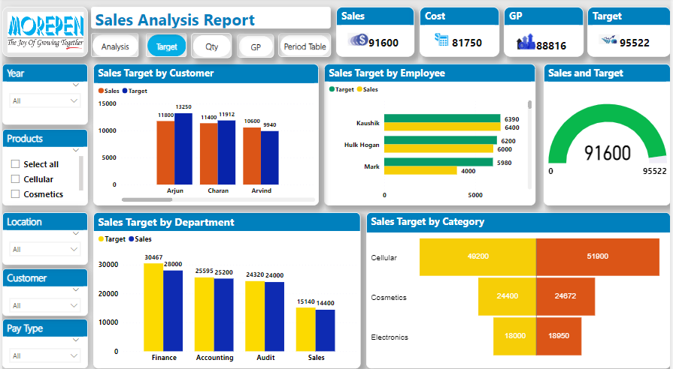
On this page, I show the actual sales against the sales target.
Every visual shows the comparison of actual sales with target sales in different categories.

Slide 6
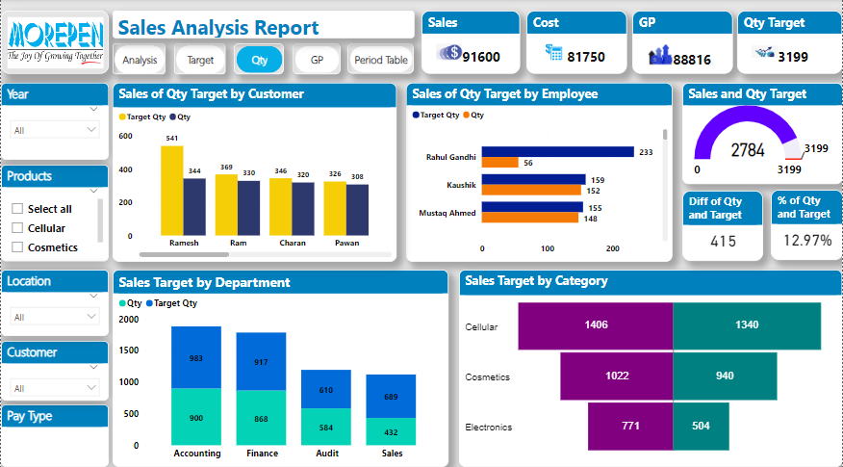
On this page, I show the actual sales quantity against the quantity target.
Every visual shows the comparison of actual quantity sales with quantity target in different categories.

Slide 7
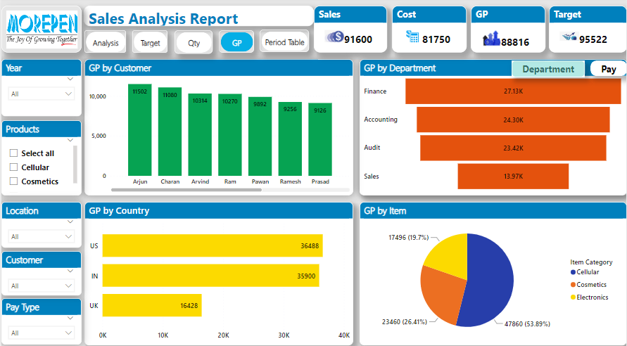
On this page, GP is shown in every visual that shows the GP margin against the different categories.

Slide 8
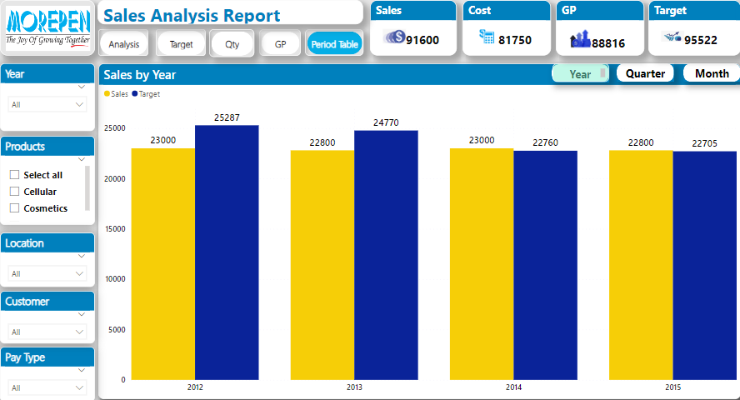
On this page, I display the period's actual sales. In this period view, I show the sales data by year, quarter, and month.

Slide 9
Health Analysis Report
The main purpose of a health analysis report is to assess and evaluate the overall health and well-being of a particular subject or entity. Health analysis reports are commonly used in various fields, including healthcare, business, and environmental sciences, to name a few. The specific objectives and scope of a health analysis report can vary depending on the context and the subject under consideration.
Under this report I have shown all the aspects such as health analysis, patient analysis, repeated patient, and matrix view. By doing this, I have made 4 separate pages in the health report, and each page has different sets of visuals that give a detail related to the health analysis.

Slide 10
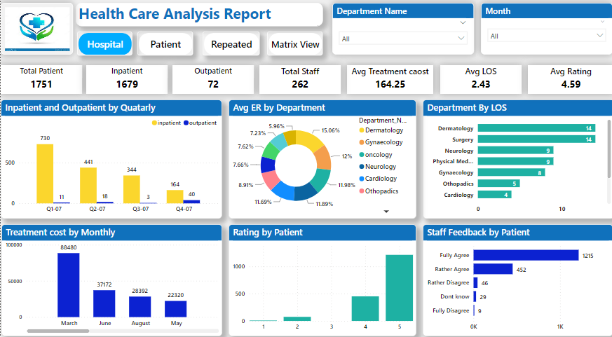
On this page, I showed the all-hospital overview, like the total number of patients, how many of those patients are inpatients or outpatients, total number of staff member and what is the rating and feedback of the hospital, etc.

Slide 11
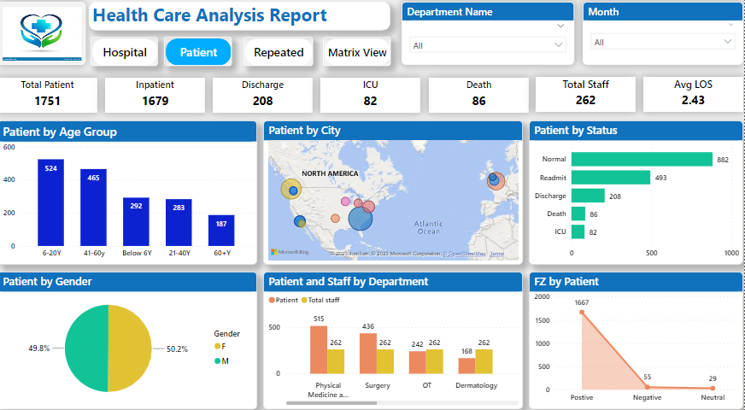
On this page, I showed the patient detail analysis, in which all the visuals are present, which gives the patient detail analysis.

Slide 12
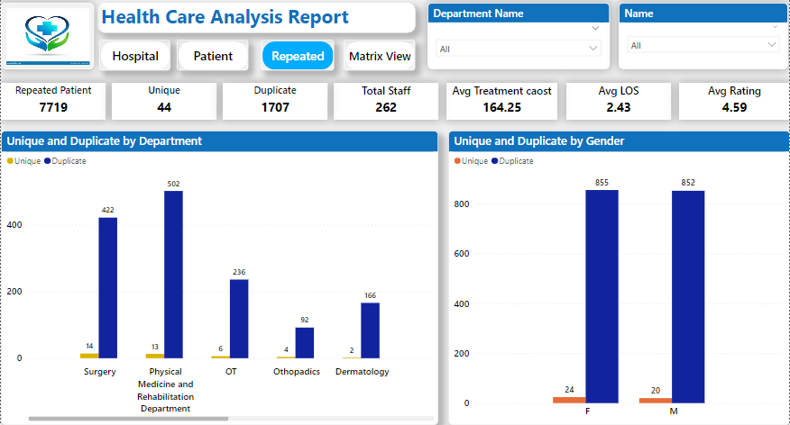
On this page I showed the comparison of unique and duplicate patients which means how many patient are new and come one time in hospital and how many patient are repeated and come more then one time.

Slide 13
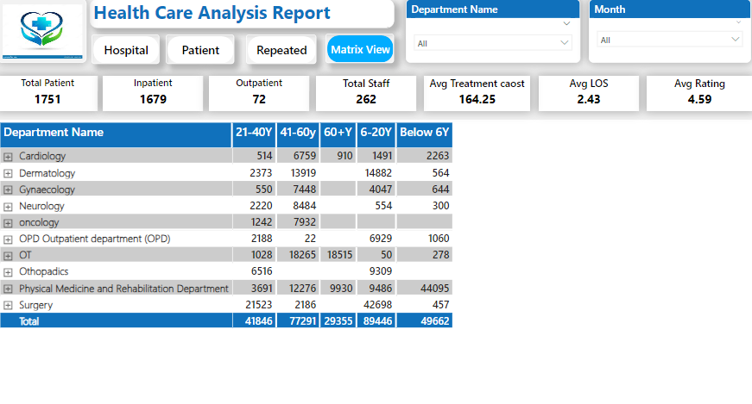
On this page I showed the matrix table of hospital in detail.

Slide 14


